Slide 1





Burnz Buttly
DATA STRUCTURE
Students: Karen Milena Espitia Doncel 3000059353
Yonier Samir Zapata Asprilla 30000058872
Cristian Camilo Forero Murillo 30000056883
Teacher: Luis Eduardo Barreto Santamaría

Slide 2

1.
2.
3.
4.
Analysis
Design
Development
Next point
2.1. Sketch
2.2. Mockups
2.2.1. Login
2.2.2. Registry
2.2.3. Menu
2.2.4. Manage inventory
2.2.5. Modify inventory
2.2.6. Review Inventory
2.2.7. Manage users
2.2.8. Modify Users
2.3. Class diagram
2.4. Databases
2.4.1.Relationship model (DB)
2.4.2.Database script (DDL)
3.1. Screenshots Java graphic interfaces
3.2. Data structure
3.3. Project source code
3.3.1. Packages and classes
3.3.2. Model, view and controller
3.3.3. Libraries
1.1. Business Logic
1.1.1 Logo
1.1.2 Company name
1.2.Description of the problem
1.3.Solution description
1.4. Stakeholders
1.5. Requeriments list

Slide 3
1.
Analysis

Slide 4




1.1.
Business logic
1.1.1.
Logo
1.1.2.
Company name

Slide 5
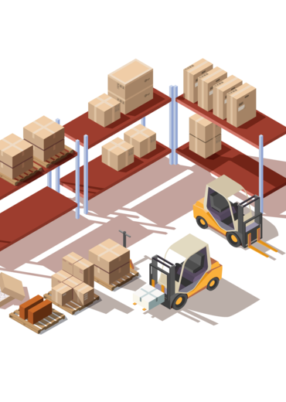
Description of de
problem
1.2.
Dealerships require a software solution that allows them to manage their inventory. Specifically, information about vehicles and different products offered by the dealer will be stored
1.3.
Solution description
An app will be created as an software solution for dealerships. This app will allow the user store and administrate an inventory. Two types of users will be created: admin and user (clients). Both types of users have a login when starting the application, respectively when entering the application each type of user will have a different menu.

Slide 6

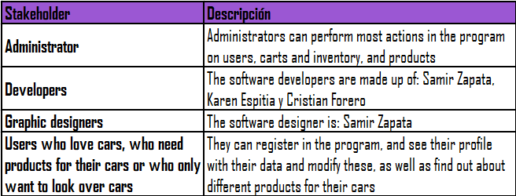
1.4.
Skateholders

Slide 7

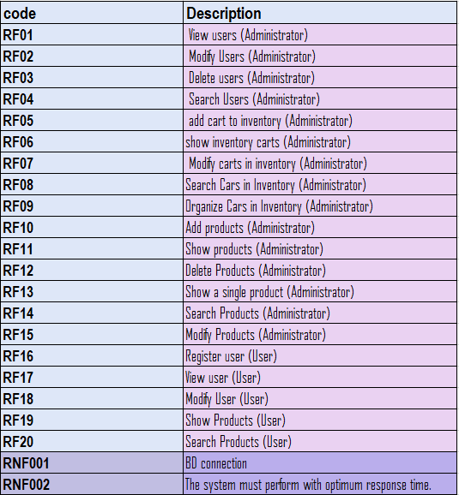
1.5.
Requeriment list

Slide 8
2.
Design

Slide 9
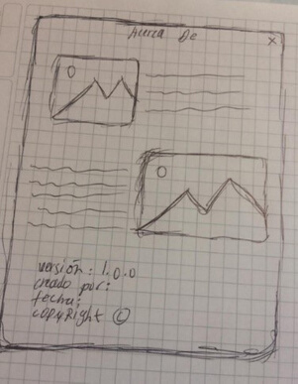
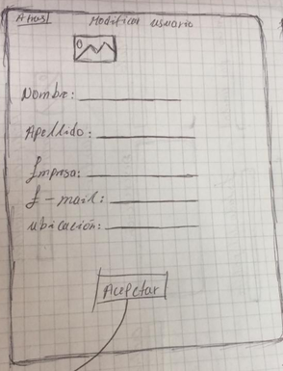
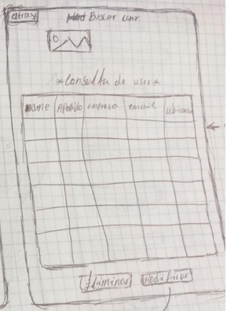
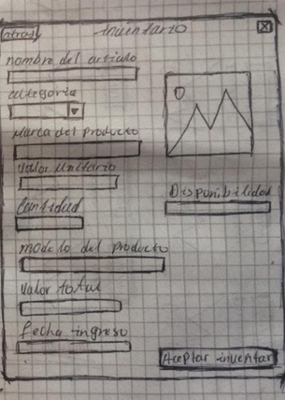
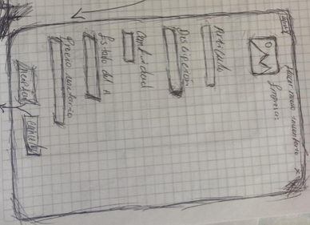
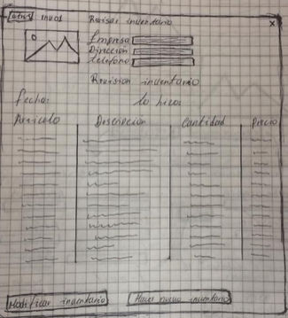
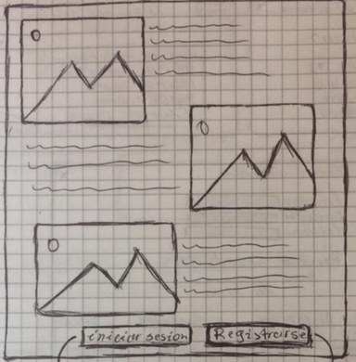
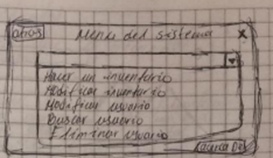

2.1.
Sketch

Slide 10
2.1.
Sketch

Slide 11
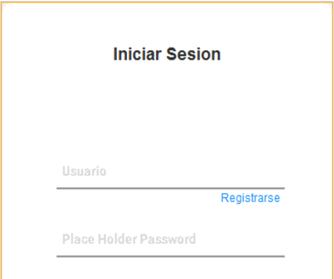
2.2.
Mockups
2.2.1.
Login

Slide 12
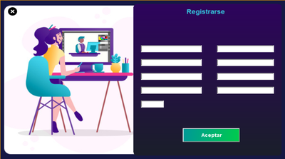
2.2.
Mockups
2.2.2.
Registry

Slide 13
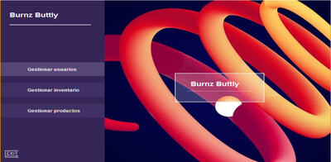
2.2.
Mockups
2.2.3.
Menu

Slide 14
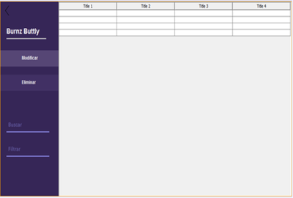
2.2.
Mockups
2.2.3.
Manage inventory

Slide 15
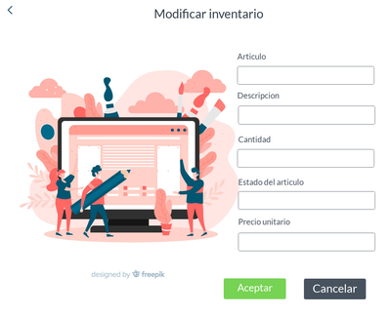
2.2.
Mockups
2.2.4.
Modify inventory

Slide 16
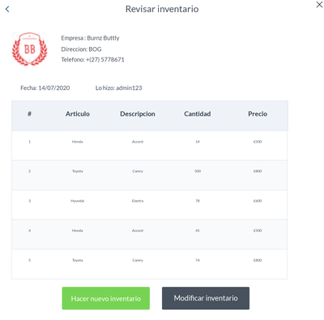
2.2.
Mockups
2.2.6.
Review inventory

Slide 17
2.2.
Mockups
2.2.7.
Manage users

Slide 18
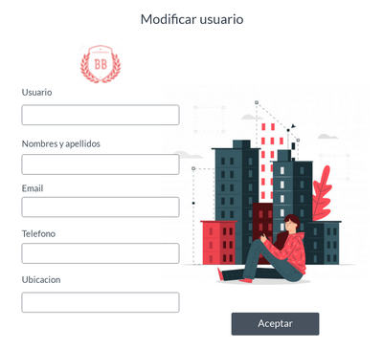
2.2.
Mockups
2.2.8.
Modify users

Slide 19
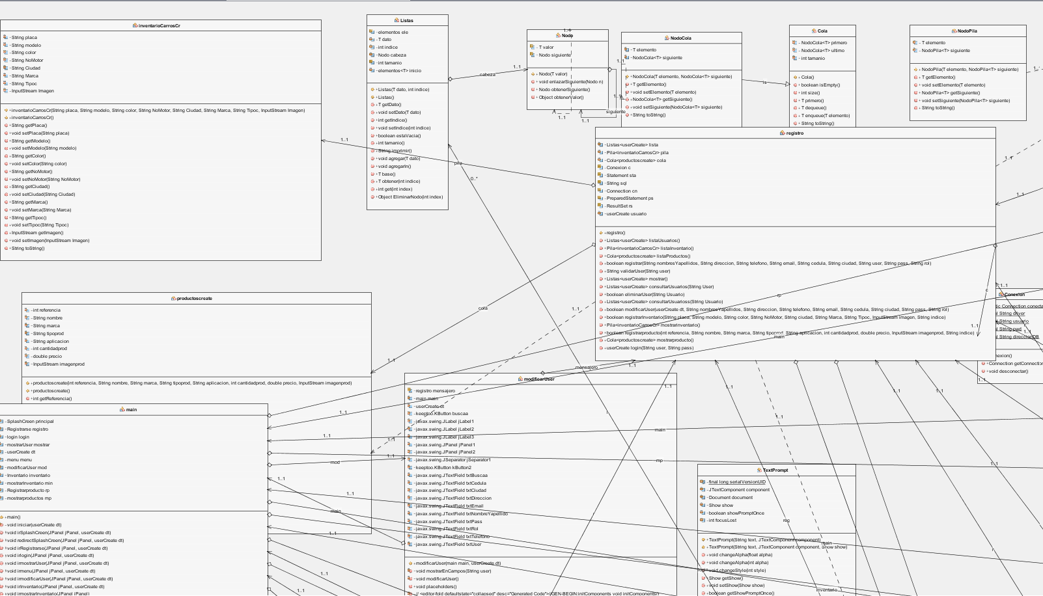
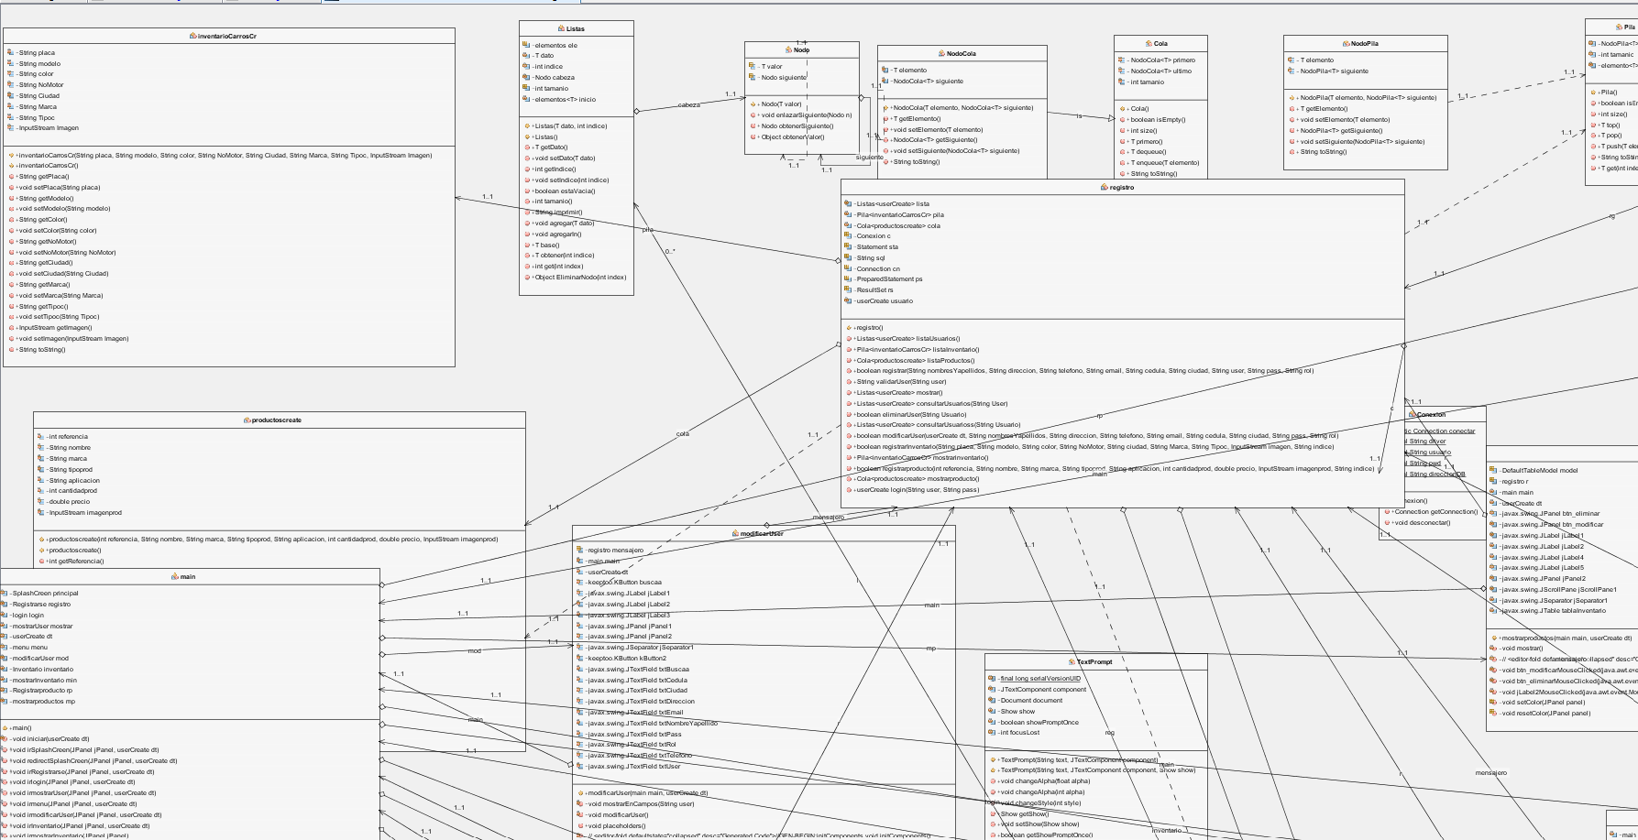
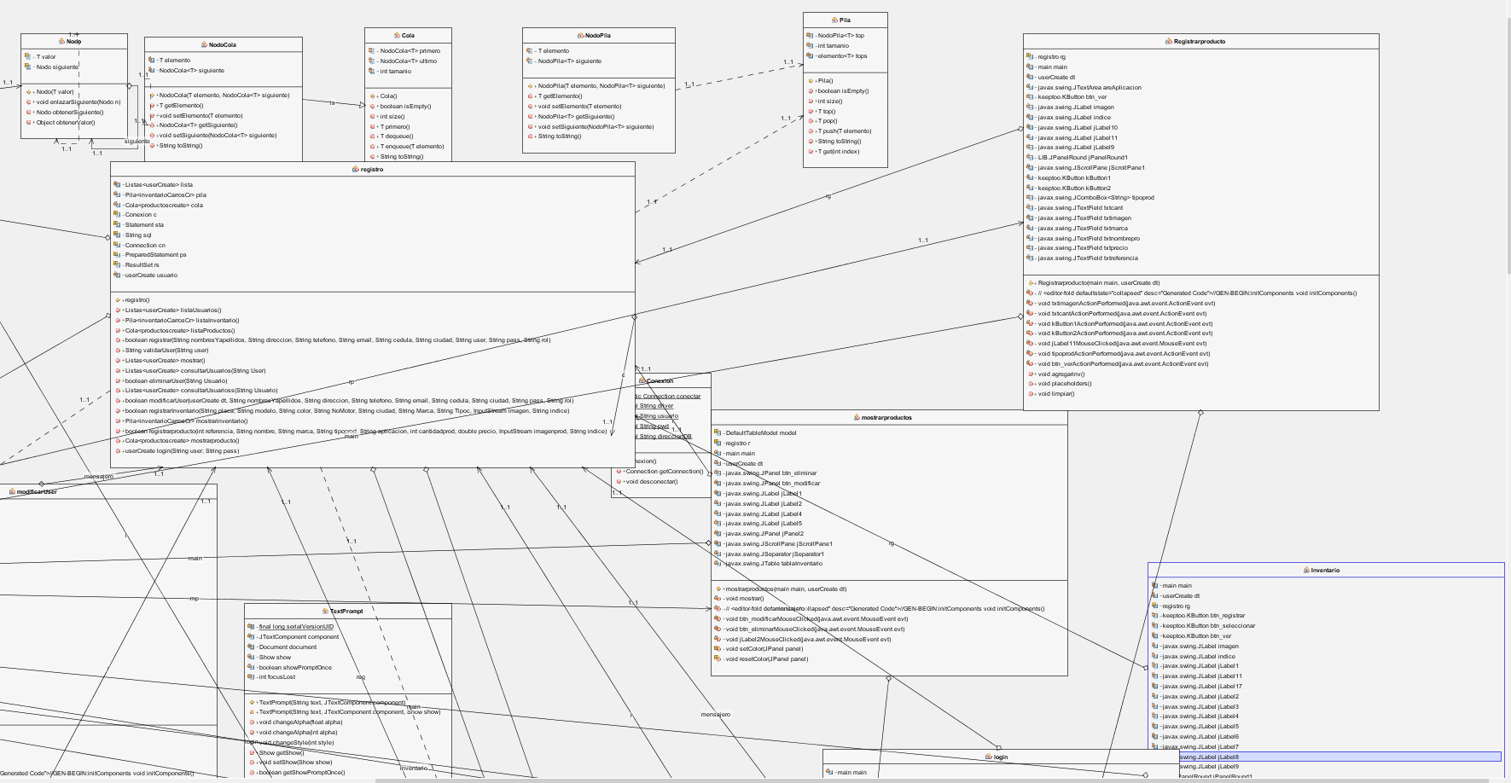
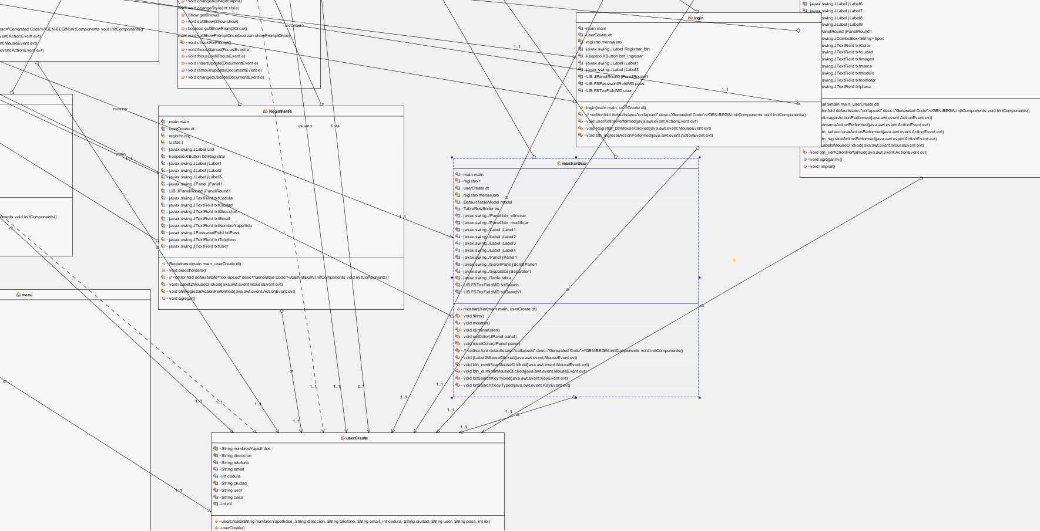
2.3.
Class diagram

Slide 20
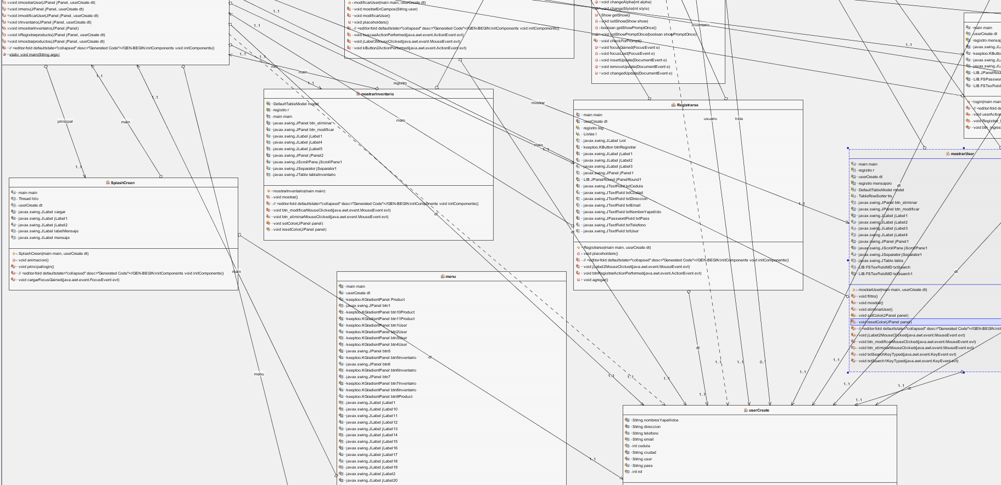
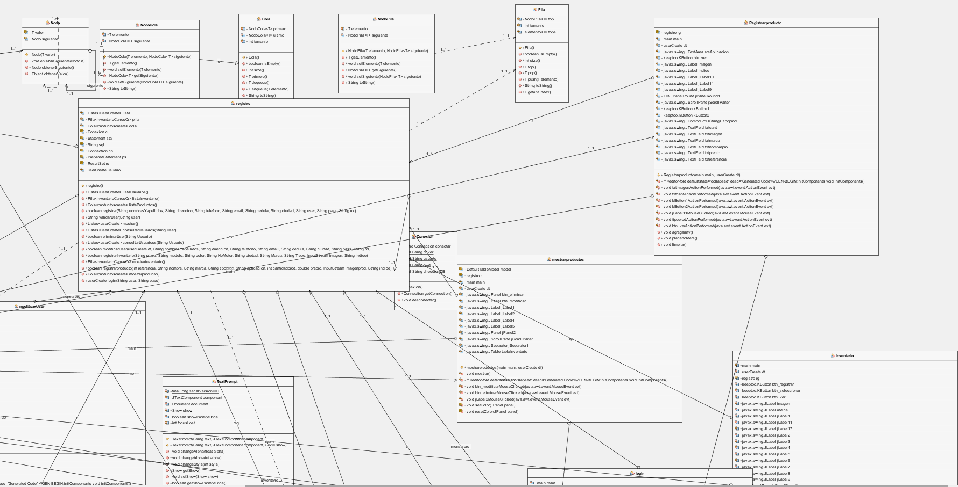
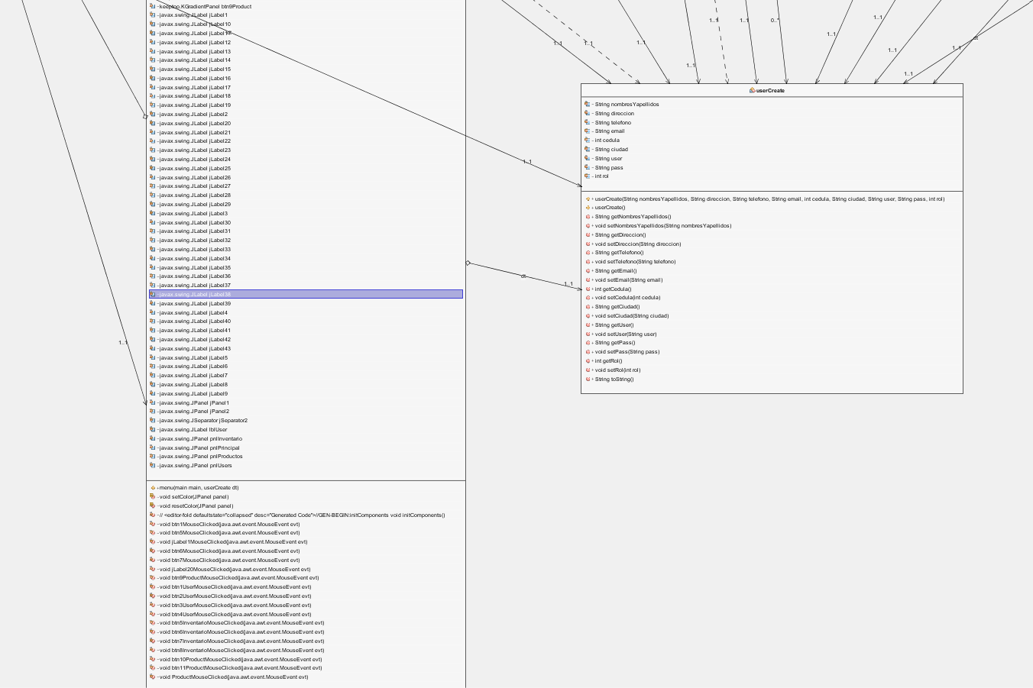
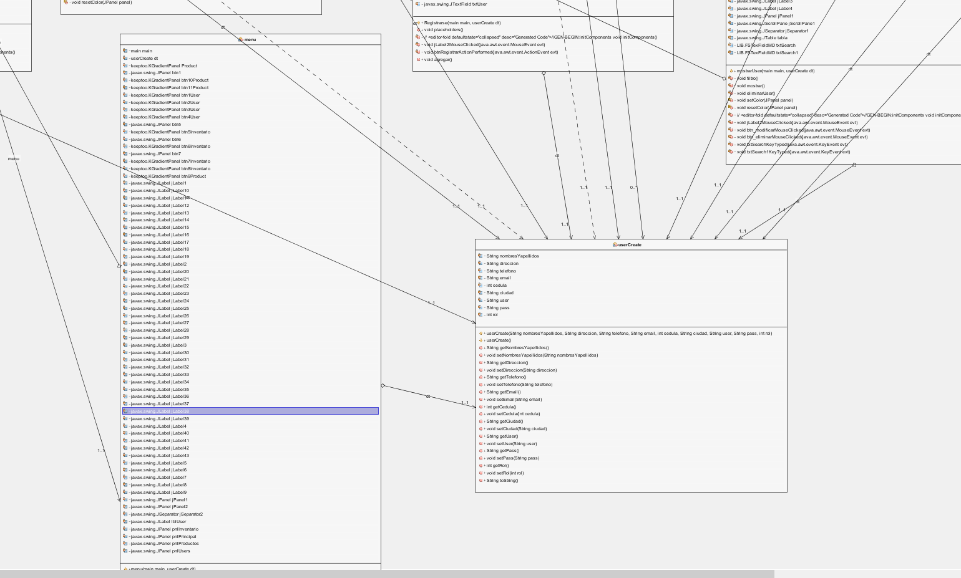
2.3.
Class diagram

Slide 21
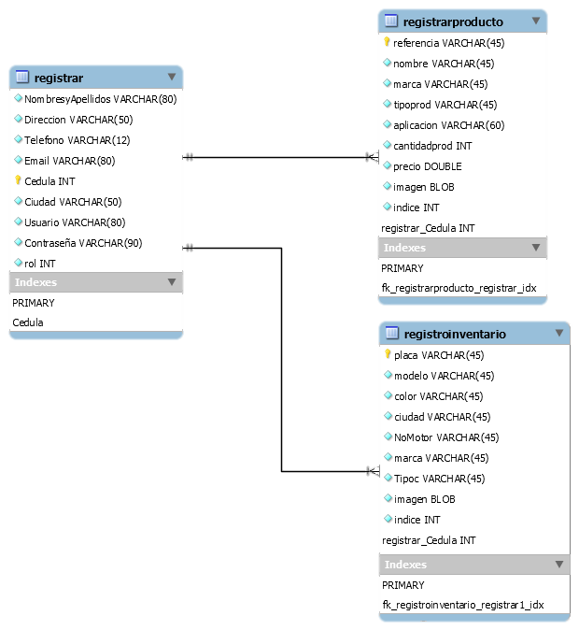
2.4.
Data bases
2.4.1.
Relational model (DB)

Slide 22
2.4.
Data bases
2.4.2.
Database script (DDL)
CREATE database burnz_buttly;
CREATE TABLE burnz_buttly.registrar (
NombresyApellidos
VARCHAR(80) NOT NULL,
Direccion
VARCHAR(50)NOT NULL,
Telefono INT NOT NULL,
Email VARCHAR(80) NOT NULL,
Cedula INT NOT NULL,
Ciudad VARCHAR(50) NOT NULL,
Usuario VARCHAR(80) NOT NULL,
Contraseña VARCHAR(90) NOT NULL,
rol INT,
PRIMARY KEY (Cedula)
);
CREATE TABLE burnz_buttly.registroinventario (
placa VARCHAR(45) NOT NULL,
modelo VARCHAR(45)NOT NULL,
color VARCHAR(45) NOT NULL,
ciudad VARCHAR(45) NOT NULL,
NoMotor VARCHAR(45) NOT NULL,
marca VARCHAR(45) NOT NULL,
Tipoc VARCHAR(45) NOT NULL,
imagen blob NOT NULL,
indice INT,
PRIMARY KEY (placa)
);
CREATE TABLE burnz_buttly.registrarProducto (
referencia VARCHAR(45) NOT NULL,
nombre VARCHAR(45)NOT NULL,
marca VARCHAR(45) NOT NULL,
tipoprod VARCHAR(45) NOT NULL,
aplicacion VARCHAR(60) NOT NULL,
cantidadprod INT NOT NULL,
precio DOUBLE NOT NULL,
imagen blob NOT NULL,
indice INT,
PRIMARY KEY (referencia)
);
SET
GLOBAL time_zone = '-3:00';

Slide 23
3.
Development

Slide 24
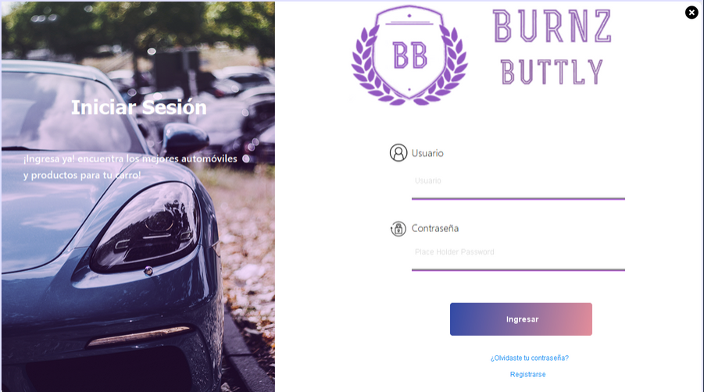
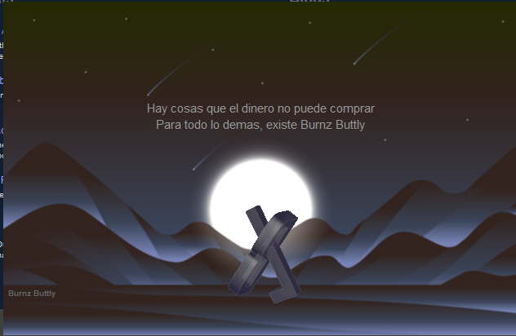
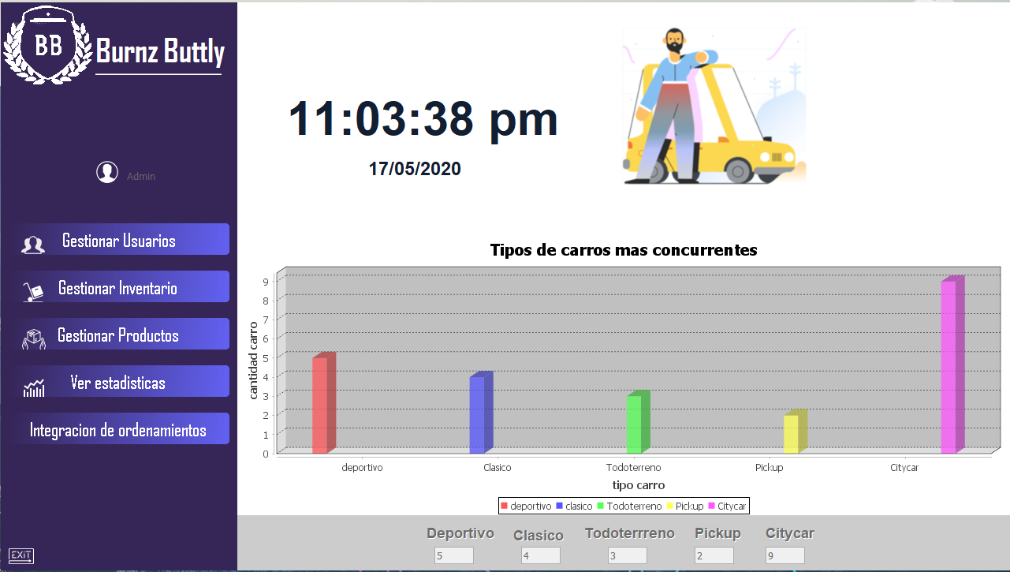
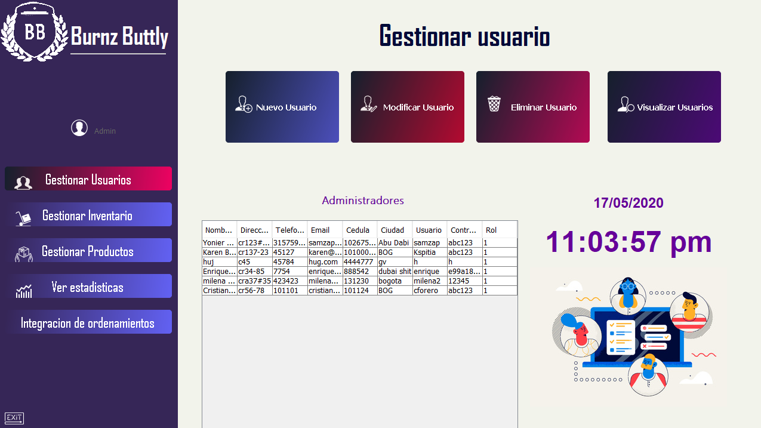
3.1.
Screenshots Java Graphics Interfaces

Slide 25
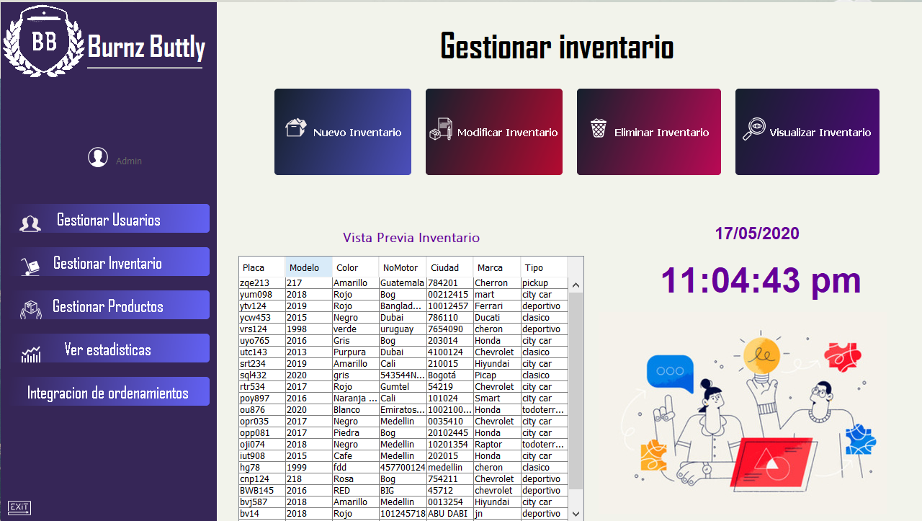
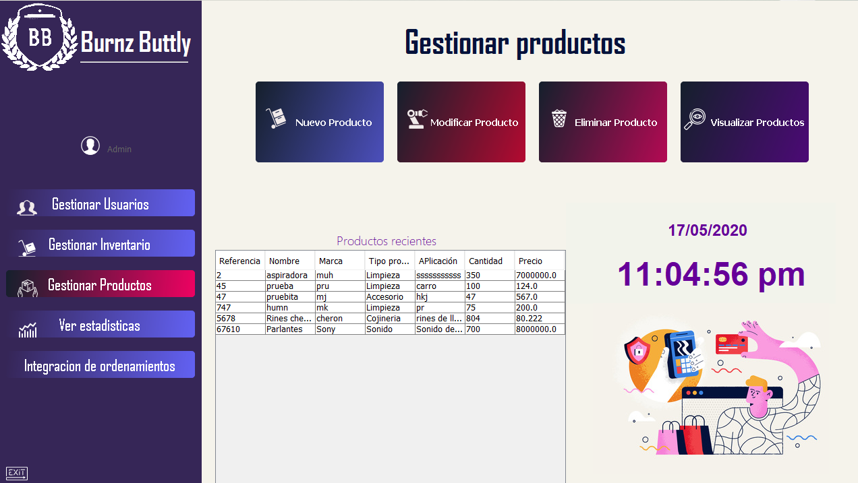
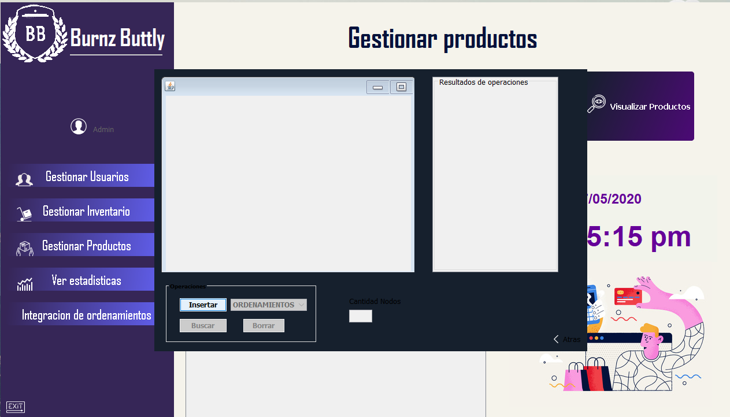
3.1.
Screenshots Java Graphics Interfaces

Slide 26
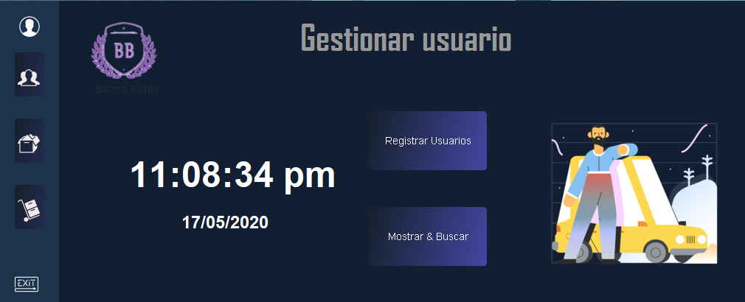
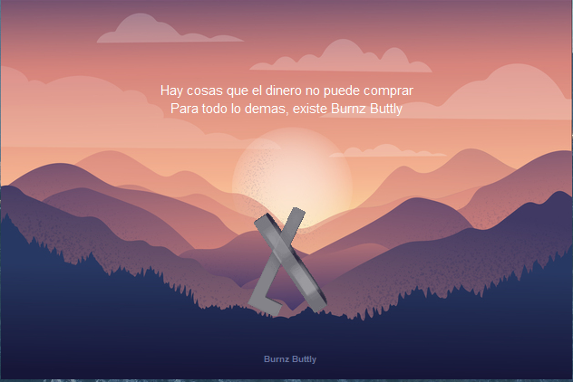
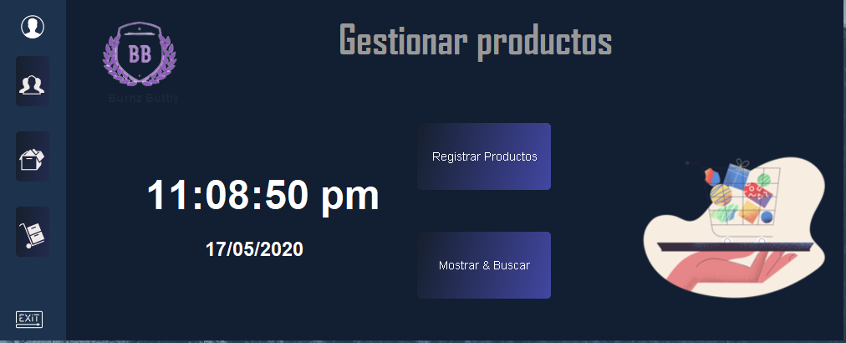
3.1.
Screenshots Java Graphics Interfaces

Slide 27

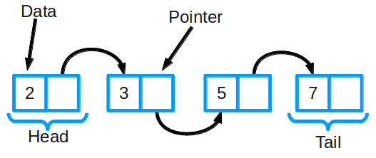
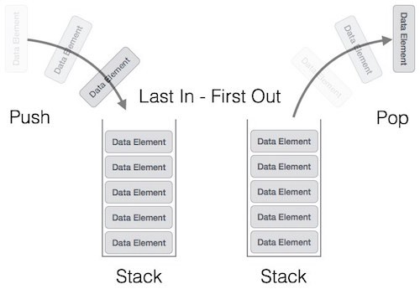
3.2.
Data structure
List
Stack

Slide 28
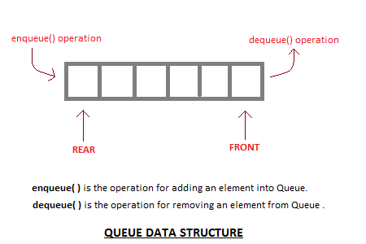
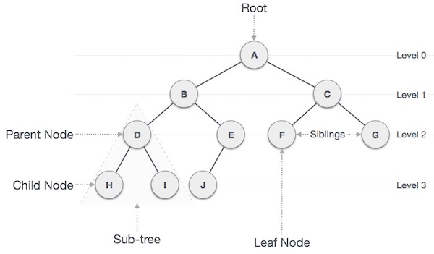
3.2.
Data structure
queue
true

Slide 29
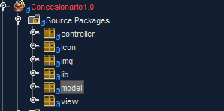
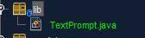
3.3.
Project source code
3.3.1.
Packages and classes

Slide 30
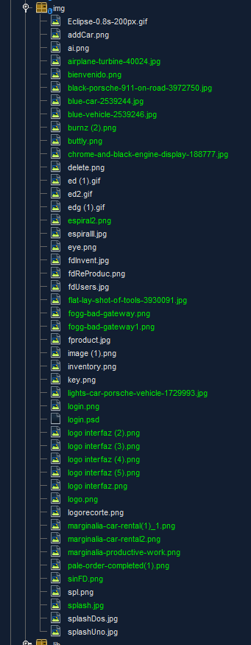
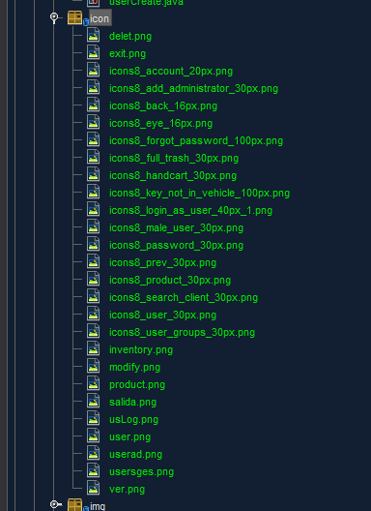
3.3.
Project source code
3.3.1.
Packages and classes

Slide 31
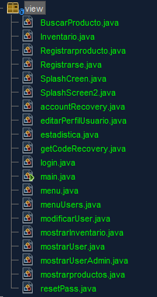
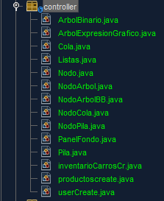
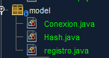
3.3.
Project source code
3.3.2.
Model, view and controller

Slide 32
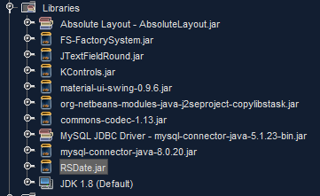
3.3.
Project source code
3.3.3.
Libraries

Slide 33
4.
Next point

